Slide 1
IMDB MOVIE ANALYSIS
BY
M N SURAJ
--

Slide 2
CAPSTONE POWER BI PROJECT:IMDB MOVIES
AIM:In this project, I'm going to preprocess and clean data, run exploratory data analysis (EDA) and find descriptive statistical measurements, finding the correlation among variables as well as analysis data with making an interactive dashboard for a dataset which contains nearly 7000 movies' data.
Language, libraries, tools:
Language: Python
Libraries: Pandas, NumPy
Application: Microsoft Excel, Microsoft Power BI

Slide 3
Data:
There are 6820 movies in the dataset (220 movies per year, 1986-2016). Each movie has the following attributes
Budget: the budget of a movie. Some movies don't have this, so it appears as 0
Company: the production company
Country: country of origin
Director: the director
Genre: main genre of the movie.
Gross: revenue of the movie
Rating: rating of the movie (R, PG, etc.)
Released: release date (YYYY-MM-DD)
Runtime: duration of the movie
Score: IMDb user rating
Votes: number of user votes
Star: main actor/actress
Writer: writer of the movie
Year: year of release

Slide 4
DATA PREPROCESSING
Import libraries
2)Load Dataset

Slide 5
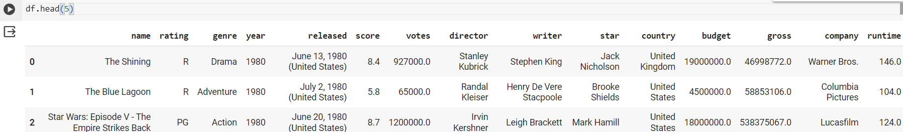
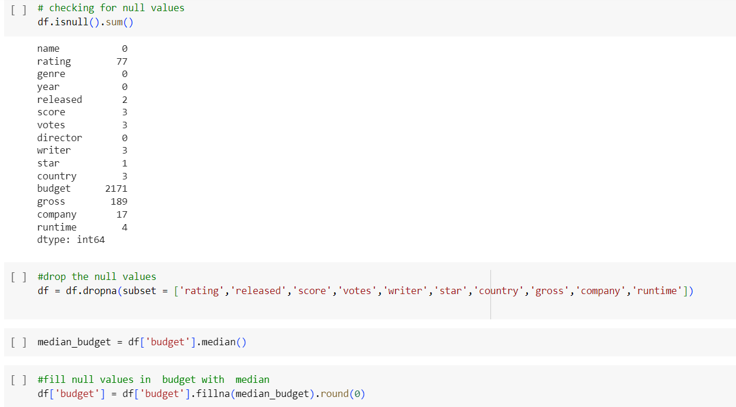
DATA PREPROCESSING
3)Look at the data
4)Handle the missing values

Slide 6
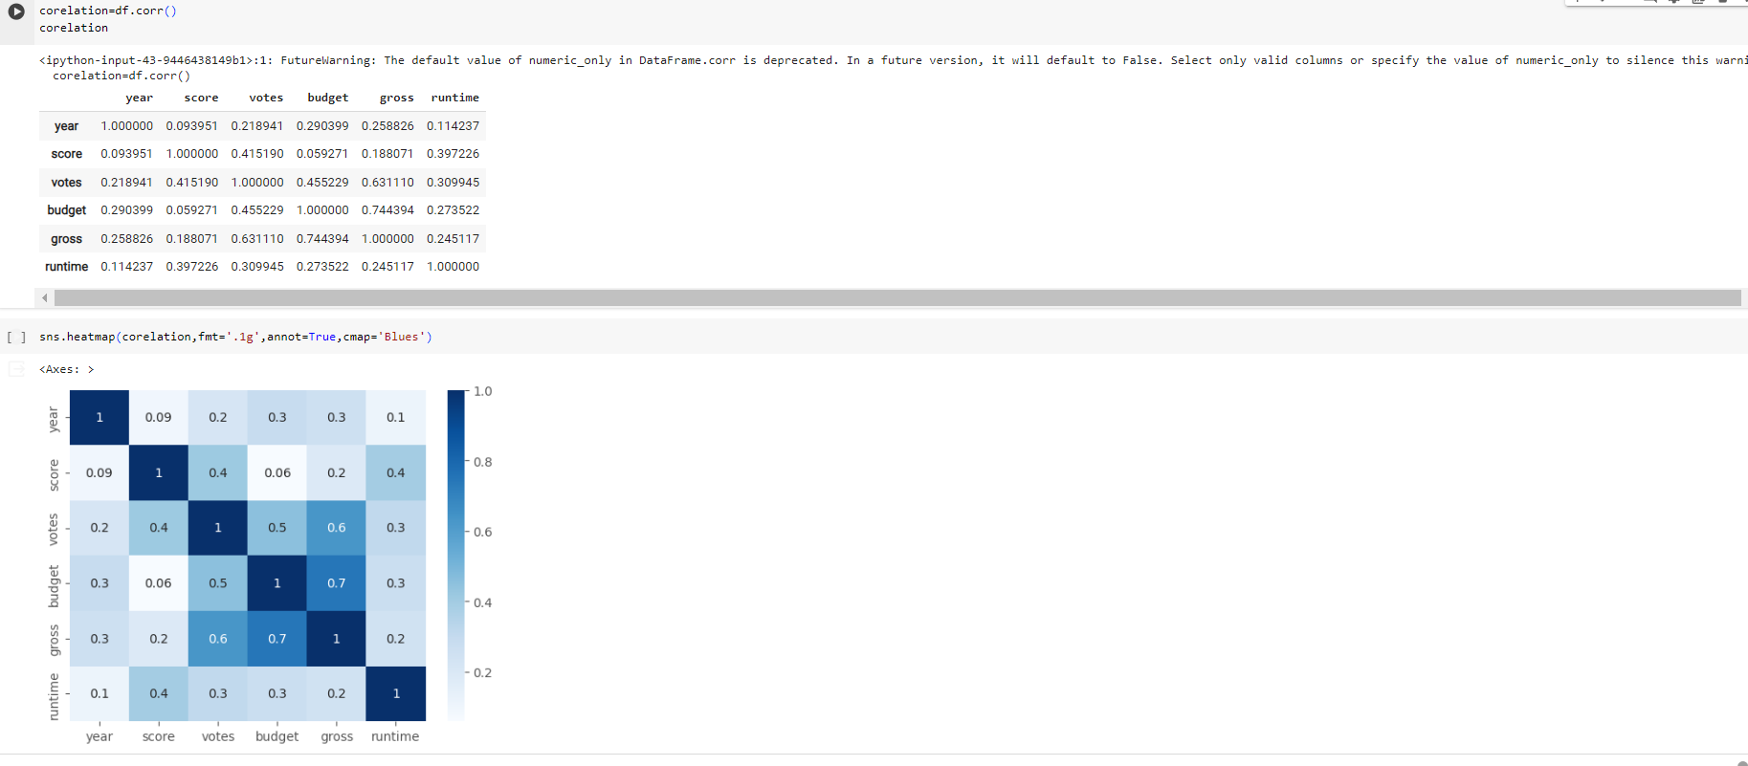
Corelation Analysis
Checking the corelation between the variables

Slide 7
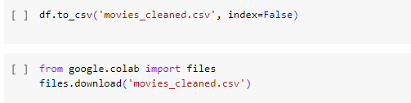
Data preprocessing
5)Downloading the updated csv

Slide 8
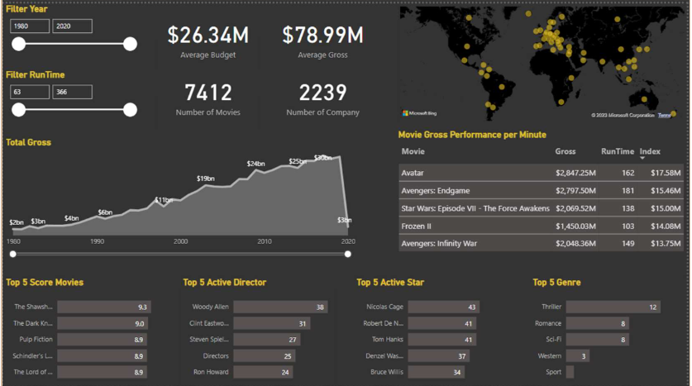
Data visualization
1)Dashboard

Slide 9
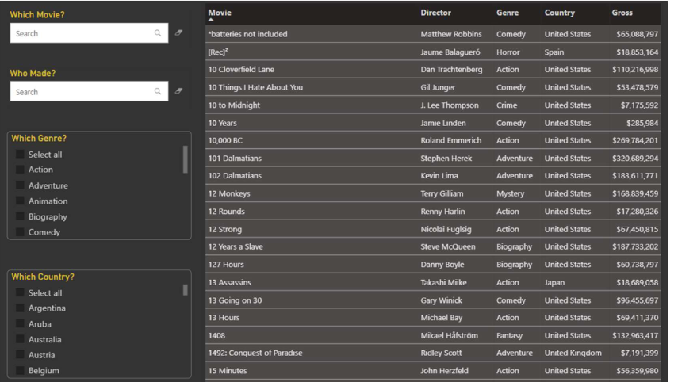
Data visualization
2)Movie Table

Slide 10
M N SURAJ
..
..
…
…

